Slide 1
EFFICIENT MANHOLE VISUAL INSPECTION USING DEEP LEARNING IN UAV NAVIGATION
PRESENTED BY, GUIDED BY,
SELVABHARATHI.P - (820620104051) MRS. SUDHA.R.,M.E,
MOHAMED BASITH.B - (820620104308) ASSISTANT PROFESSOR,
VENKATESH.S - (820620104315) DEPARTMENT OF CSE,
VISWAM.S - (820620104316) ARASU ENGINEERING COLLEGE.

Slide 2
OBJECTIVE
The objective of this project is to paper proposes a rapid road manhole detection method using computer vision and deep learning techniques.
To monitor the system and to detect various states of a manhole, like a lid opening, detection of the light, detection of the object or person presence, etc.
To locate and identify the road manholes.

Slide 3
INTRODUCTION
Artificial intelligence and machine learning continue to show promising results for a wide-range of cybersecurity applications.
Deep Learning Techniques are used in computer vision - for instance, for image classification.
Using a deep learning algorithm like CNN, a machine can be trained to achieve specific tasks by processing huge quantities of data and identifying patterns in it..
One of the most important tasks that is performed with this technology is Fake logo detection to assist in detecting fraudulent logo and other online infringements in real time.

Slide 4
ABSTRACT
Manholes are typically constructed with a cover or lid that can be removed to allow entry for inspection, maintenance, or repair of utility infrastructure such as sewers, storm drains, telecommunications, electrical, or gas systems.
Manholes are often located in public areas, and their covers need to be secure to prevent accidents. Manual observation, the traditional approach to monitoring manhole covers, faces challenges such as labour shortages and ethical concerns.
Identifying open or broken manholes using image processing algorithms faces challenges related to variable image quality, complex backgrounds, scale changes, and dynamic environmental conditions.
In response to this difficulty the aim of this project proposes an automated system architecture based on deep learning models to replace the manual examination process.
The project involves the development of a ManholeNet model capable of analyzing images of manhole covers.
Algorithms - Yolo V8 ,Convolution Neural Networks.

Slide 5
LITERATURE SURVEY
Paper Info | Methodology | Algorithm | Merits | Demerits
1 Real-time Detection of Road Manhole Covers with a Deep Learning Model Author: Mehmet Akif Yaman, Frank Rattay, Abdulhamit Subasi Year:2021. | The MGB-YOLO model was developed by optimizing the YOLOv5s network with MobileNet-V3, Global Attention Mechanism (GAM), and Bottleneck CSP. | MGB-YOLO model incorporates MobileNet-V3, GAM, and Bottleneck CSP into the YOLOv5s network for optimized performance | Achieved an impressive accuracy of 96.6%. Outperformed existing models (Faster RCNN, SSD, YOLOv5s, YOLOv7, YOLOv8s) with increased mean average precision (MAP). | The model's performance with real-time detection standards.
2: Data-Augmented Deep Learning Models for Abnormal Road Manhole Cover Detection Author:Mehmet Akif Yaman, Frank Rattay, Year:2021 | Extraction of manhole cover samples using a method proposed by the authors. Application of a simple copy and paste algorithm to improve the model's effectiveness. | Deep learning framework for abnormal manhole cover detection. New data augmentation method involving perspective transformation. | Enhanced abnormal manhole cover detection performance, as evidenced by the improved MAP (at least 6.8 higher compared to the baseline model) | Data augmentation method based on deep learning is mentioned to be more time-consuming during training compared to traditional methods.
Paper Title 3:Design and Implementation of Manhole Cover Safety Monitoring System based on Smart Light Pole
Author:
Year:2022.
objective of the study is to propose a safety monitoring system for manhole covers based on smart light poles.
processes and controls various data related to manhole covers, including movement, loss, tilt, flooding, and positioning.
The data frame is transmitted to the LoRa gateway of the nearby smart light pole using the LoRa communication protocol.
STM32F103C8T6 microcontroller, LoRa communication protocol, and an integrated package for the terminal sensing control device
Efficient and accurate realization of all-round and multi-modal safety linkage monitoring of urban manhole covers
challenging related details about the algorithms
Paper Title 4: Detection and Localization of Manhole and Joint Covers in Radar Images by Support Vector Machine and Hough Transform
Author:Takahiro Yamaguchi, Tsukasa Mizutani
Year:2021
detection and localization of manhole and joint covers in radar images using a combination of Support Vector Machine (SVM) and Hough transform.
Utilization of Ground Penetrating Radar (GPR) for capturing radar images.
Development of a Support Vector Machine (SVM.
Support Vector Machine (SVM): The machine learning model is trained with features extracted using Histogram of Oriented Gradient (HOG) and Laplacian filter.
High Classification Accuracy: The SVM model achieved a classification accuracy of up to 98% for manhole, joint covers, and pavement sections
The information provided does not include a reference link for further details and validation of the presented work.

Slide 6
EXISTING SYSTEM
Manual Visual Inspection
Trained inspectors visually inspect manholes.
Findings manually entered into a database.
Time-consuming and prone to errors.
Image Processing-Based System
Uses techniques like Sobel Edge Detection, Morphological Operations, and Thresholding.
Provides automation and can detect defects not easily visible.
Machine Learning-Based System
Utilizes algorithms such as Decision Trees, Random Forests, and Support Vector Machines.
Requires labeled data for training and offers high accuracy.

Slide 7
DISADVANTAGES
Labor-intensive manual inspection is prone to human error.
Limited coverage and frequency of inspections may miss emerging issues.
Safety risks for workers during manual maintenance tasks.
Inefficient response to emergencies due to delayed identification of issues.
Difficulty in tracking maintenance records leads to inefficiencies.
High maintenance costs due to labour-intensive processes and potential inefficiencies.
Traditional machine learning methods can be limited in their ability to learn complex features and patterns in images.
Existing machine learning systems may not be able to generalize well to different types of manholes, conditions, and defects.
Require significant computational resources and training data to achieve high accuracy.
Some existing methods may be prone to false positives and false negatives, leading to inaccurate predictions and inefficient maintenance operations.

Slide 8
PROPOSED SYSTEM
The proposed system uses deep convolutional neural network-based classifiers to identify the manhole open, close or broken.
Vision Transformer Learning
Yolo V8 is used to detect manhole
CNN is used to classify 1 – Close, 0 – Open, 2 – Broken, 4 – No Manhole.

Slide 9
ADVANTAGES
Simplified data collection and evaluation.
Suitable for drone implementation
Adequate accuracy while maintain a low computational load
Automatically detects the important features without any human supervision
Provides notifications through alert messages, push messages

Slide 10
SYSTEM REQUIREMENTS
HARDWARE REQUIREMENTS:
Processor: Intel Core i5.
RAM: 8GB or more.
Storage: SSD for faster read/write operations.
Any modern computer, laptop.
SOFTWARE REQUIREMENTS:
Operating System: Server: Windows 10 or 11.
Back end Development: Python, Flask, MySql.
Data Processing Analysis: Pandas , NumPy, Scikit Learn, Matplotlib, Seaborn.
Image Processing and Computer Vision: Opencv , Pillow.
Front end Development :HTML . CSS , Javascript , Bootstrap.
Deployment: Wamp Server, Docker.

Slide 11


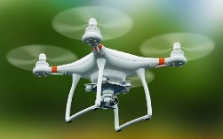

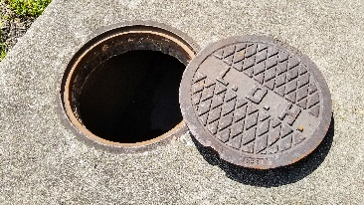
SYSTEM ARCHITECTURE
Login
Corporation Admin
Add & Manage Municipality
Upload Manhole Dataset
Build and train Model
Drone Remote Control
Assign Worker
Preprocessing
Transfer to Server
Manhole Segmentation
Corporation Server
Manhole Feature Extraction
UAV
Predict Manhole Condition
Notify Manhole Status
Capture Manhole
Municipality Office
Manhole

Slide 12
MODULES DESCRIPTION
Manhole Predictor Web App
Front End: The front-end module will be responsible for providing a user-friendly interface for the web application. It will be developed using HTML, CSS, and JavaScript.
Back End: The back-end module will be developed using Python and Flask. It will be responsible for handling the business logic of the web application.
Database: The database module will be developed using MySQL. It will be responsible for storing the user data, manhole images, and the predicted results.
User Authorization and Authentication: The user authorization and authentication module will be responsible for ensuring that only authorized users can access the web application. It will be developed using Flask-Security and will include features like user registration, login, and logout.

Slide 13
MODULES DESCRIPTION
End User Interface
Web Admin Interface
The Web Admin interface is accessible only to the authorized admin users. The admin can log in to the system with their credentials and perform various tasks like training the Manhole model, adding and deleting users, and monitoring the system logs.
Citizen or User Interface
The citizen or user interface is accessible to all registered users of the system. The user can upload the manhole images and get the prediction results of manhole defects.
Municipality Officer Interface
The Municipality Officer Interface is accessible to authorized officers who can view the defected manhole images, its location, and the severity of the damage. Based on this information, they can plan to schedule repairs for identified defects.

Slide 14
MODULES DESCRIPTION
Manhole Classifier: Build and Train
Dataset Collection
This component involves collecting a large and diverse set of manhole images to build a comprehensive dataset.
Import and Visualize Manhole Image Dataset
The import and visualize manhole image dataset module of the manhole predictor web app is responsible for importing the manhole images dataset from the user's computer or cloud storage and visualizing them in a user-friendly manner.
Pre-processing
The pre-processing module of the Manhole Predictor Web App involves several steps to prepare the manhole images for feature extraction and classification

Slide 15
MODULES DESCRIPTION
Segmentation
The Segmentation module of the Manhole Predictor Web App is responsible for identifying the region of interest (ROI) in the manhole image.
Feature Extraction
The Feature Extraction module of the Manhole Predictor Web App is responsible for extracting important features from the segmented manhole images.
Classification
The classification module of the Manhole Predictor web app is responsible for predicting the condition of the manhole image
Build and train Model
The Build and Train module of the Manhole Predictor Web App is responsible for building and training the deep learning models used for manhole classification, prediction, and localization.

Slide 16
MODULES DESCRIPTION
Manhole Predictor
Input Image: The input image of the manhole is received from the user interface.
Pre-processing: The input image is pre-processed, which includes converting the RGB image to grayscale, resizing the image to a standard size, de-noising the image, and binarizing it.
Segmentation: The pre-processed image is then passed through a region proposal network (RPN) to segment the manhole cover from the background.
Feature Extraction: After segmentation, grey-level co-occurrence matrix (GLCM) features are extracted from the segmented manhole cover image.
Classification: The extracted features are then used as input to a convolutional neural network (CNN) for classification of the manhole cover's condition.

Slide 17
MODULES DESCRIPTION
Prediction: The output of the CNN is the predicted class of the manhole cover's condition (1-Close, 0-Open, 2-Broken, 4-No Manhole).
Output: The predicted class is returned as output and displayed to the user through the web app interface.
Notification
The notification module of the Manhole Predictor Web App is responsible for sending notifications to the Municipality Officer regarding the identified manhole defects.
Performance Analysis Top of Form
The performance analysis of the Manhole Predictor Web App involves evaluating the accuracy, precision, recall, and F1 score of the classification model.

Slide 18
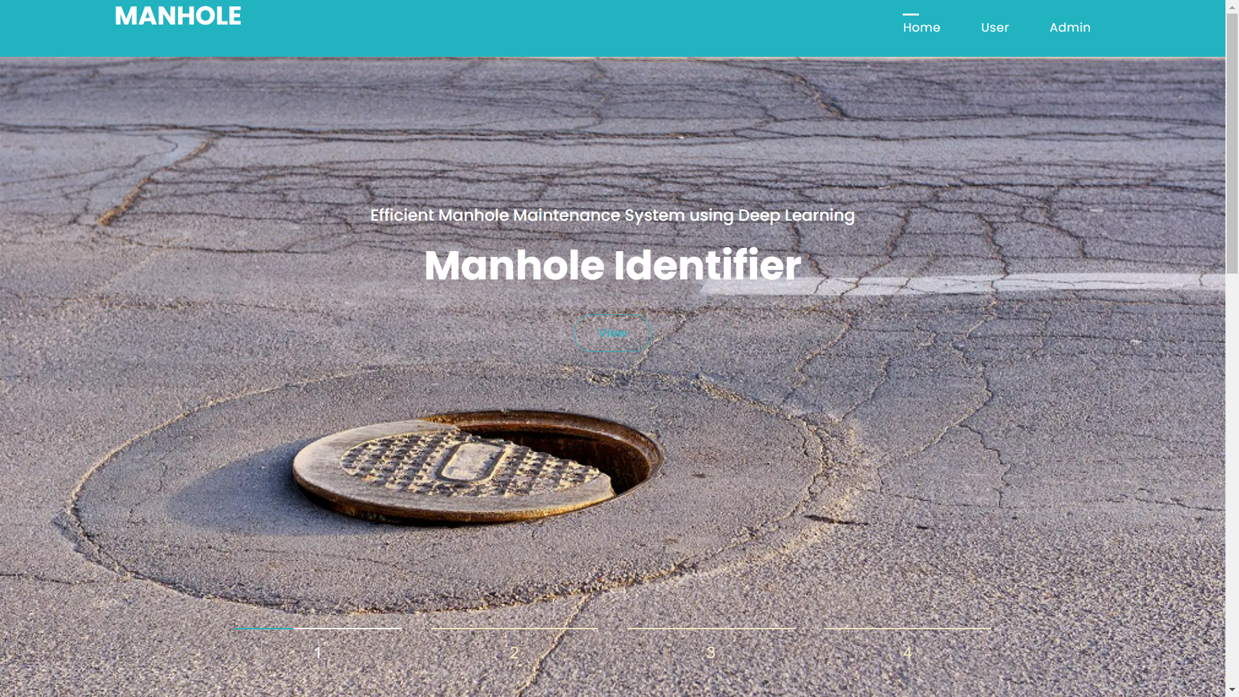
IMPLEMENTATION SCREENSHOT

Slide 19
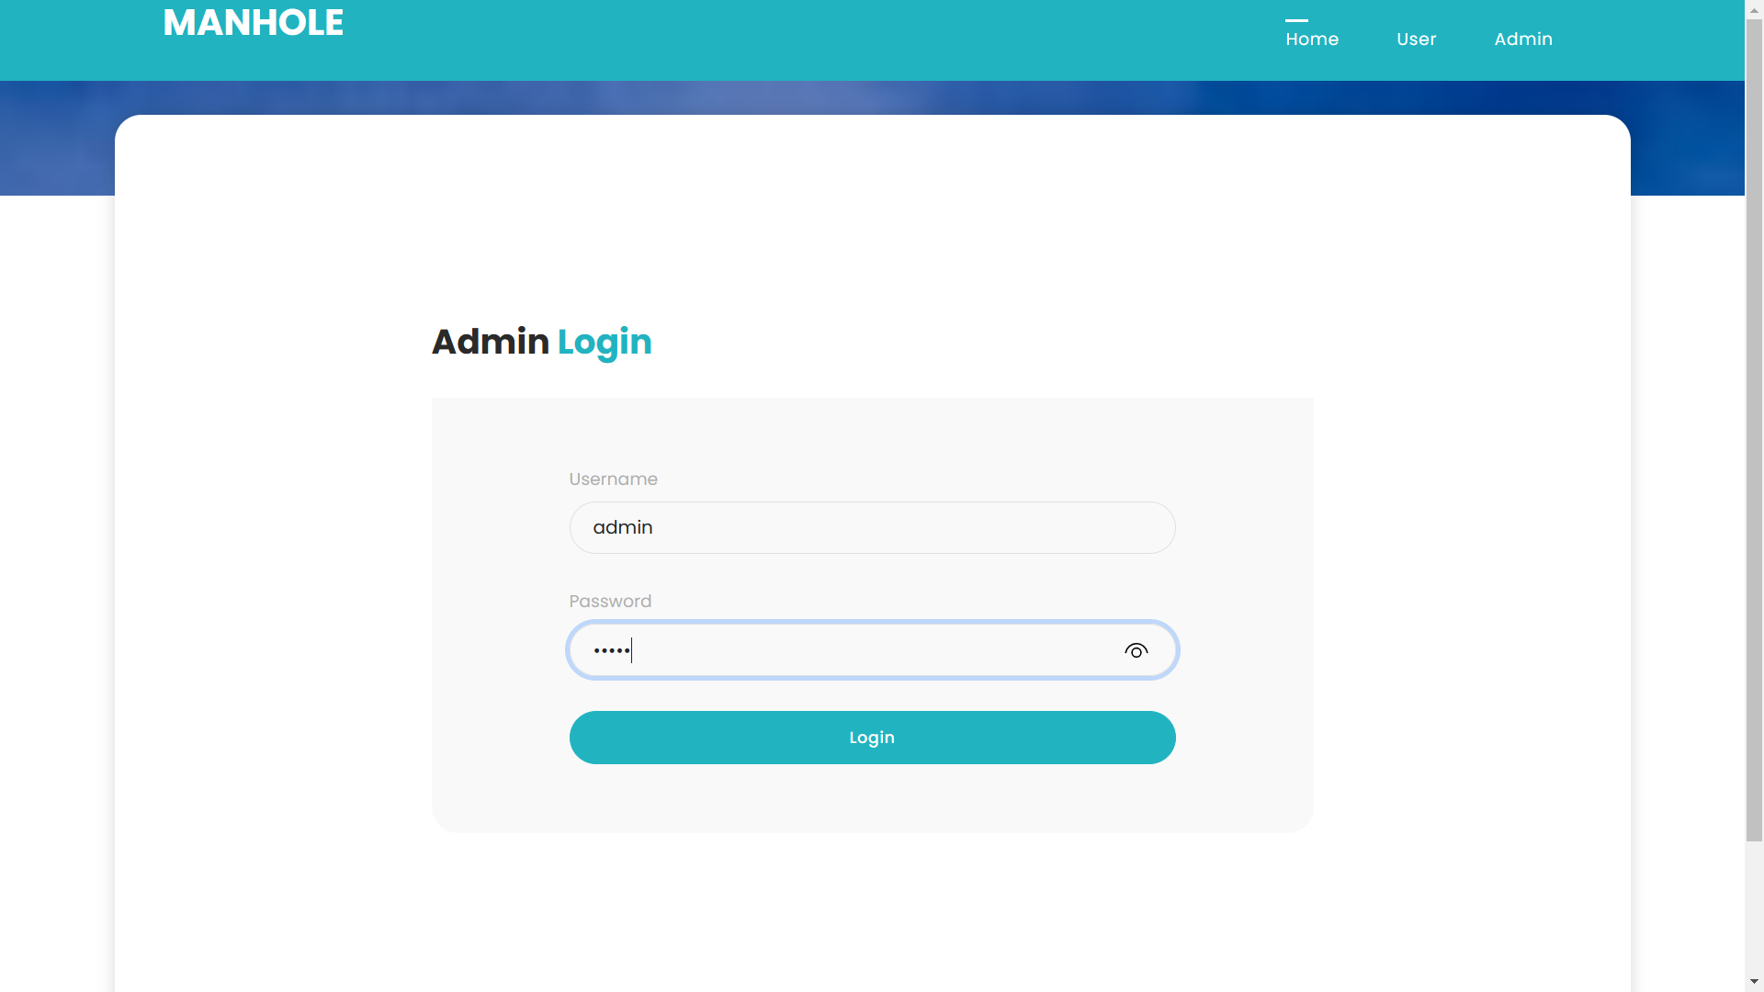
IMPLEMENTATION SCREENSHOT

Slide 20
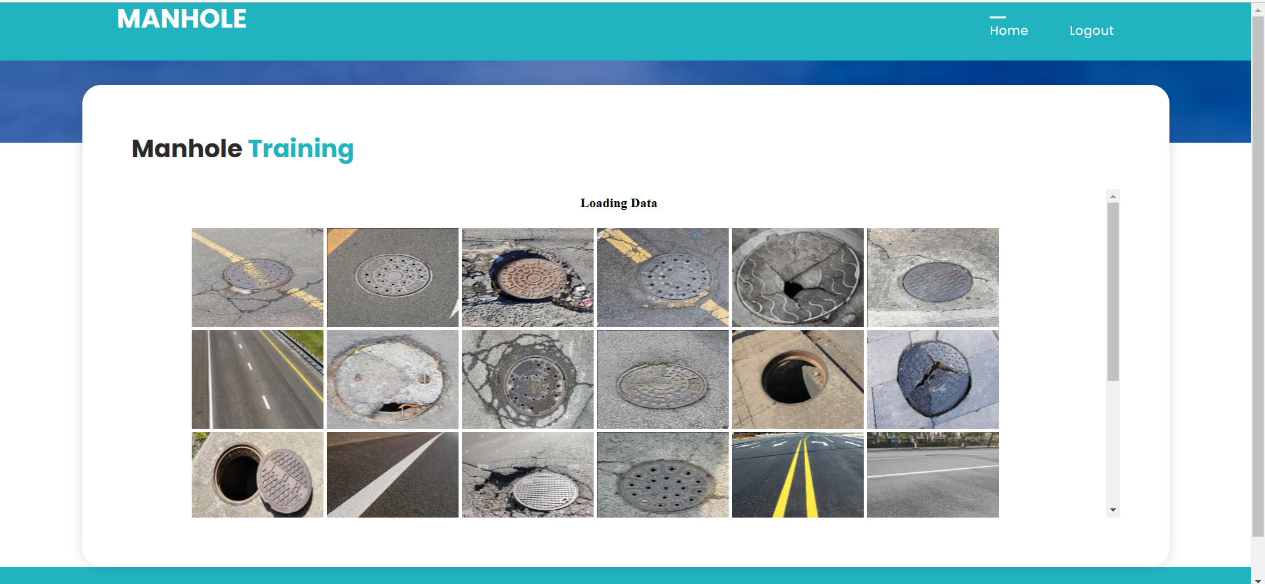
IMPLEMENTATION SCREENSHOT

Slide 21
CONCLUSION
In conclusion, the development and implementation of the Manhole Predictor Web App represent a significant advancement in infrastructure maintenance practices.
The proposed system of the project utilizing advanced deep learning algorithms such as Convolutional Neural Networks (CNN) for manhole classification, Region Proposal Network (RPN) for segmentation, and You Only Look Once version 8 (YOLOv8) for accurate prediction and localization, marks a significant advancement in infrastructure maintenance practices.
The project has demonstrated the potential to revolutionize the inspection and maintenance of manhole covers in urban environments. The accuracy and efficiency of the prediction model showcased in the project's results underscore its effectiveness in accurately classifying manhole covers and predicting their conditions.
By providing municipalities and maintenance authorities with timely and precise information about the state of manhole covers, the web app enables proactive maintenance measures, ultimately enhancing urban safety and minimizing the risk of accidents.
Furthermore, the user-friendly interface and seamless communication features of the web app facilitate efficient collaboration between users and municipal officers, streamlining the maintenance process and optimizing resource allocation.
Thus this project represents a valuable tool for enhancing infrastructure management practices, contributing to safer urban environments, and laying the foundation for future advancements in smart city initiatives.
With ongoing refinement and widespread adoption, the project holds the potential to significantly improve the maintenance and safety standards of urban infrastructure systems globally.

Slide 22
FUTURE ENHANCEMENT
There are several areas for future improvement and expansion for the Manhole Predictor web app:
Automatic manhole repair scheduling: The app currently provides information about the location and type of manhole defects to the municipality officer. In the future, this information could be used to automatically schedule repairs based on factors like severity of the defect and priority of the location.
Mobile app version: A mobile app version of the Manhole Predictor could be developed to make it easier for citizens to report manhole defects. The app could use the device camera to capture images of manholes and automatically send them to the municipality officer for processing.
Integration with GIS data: The app could be integrated with geographic information system (GIS) data to provide more detailed information about manholes in a particular area. This could include information about the age of the manhole, its size, and any previous repairs that have been done.

Slide 23
REFERENCES
J. Wang and Y.T. Li, "The Main Causes and Control Measures of the Quality Problems in the Installation of Manhole Covers", China Construction, vol. 4, pp. 135-136, 2022.
H. Chen, J. Gong, H. Ning, X. Zhang and Y. Wang, "Method for detecting shape and position of double holes of photothermal support connecting plate based on monocular camera", Tool Engineering, vol. 55, pp. 91-95, 2021.
H. Ren and F. Deng, "Manhole Cover Detection Using Depth Information", Journal of Physics, vol. 1856, pp. 26-28, 2021.
Y. Yu, H. Guan, D. Li, C. Jin, C. Wang and J. Li, "Road manhole cover delineation using mobile laser scanning point cloud data", IEEE Geosci. Remote. Sens. Lett., vol. 17, no. 1, pp. 152-156, Jan 2020.
A. Bochkovskiy, C.Y. Wang and H.Y.M. Liao, "Yolov4: Optimal speed and accuracy of object detection", arXiv, 2020.

